Slide 1
Thesis research
Reproducibility of Search-Based Software Engineering

Slide 2
Objectives
Finding research papers that cover
  Multi Objective Optimization
  Many Objective Optimization(MaOP)
Assessing their Data Source
  Number of Optimization problems
  Contain decision variables for the function
  Contain constraints on the desicion variables
  Contains attributed data

Slide 3
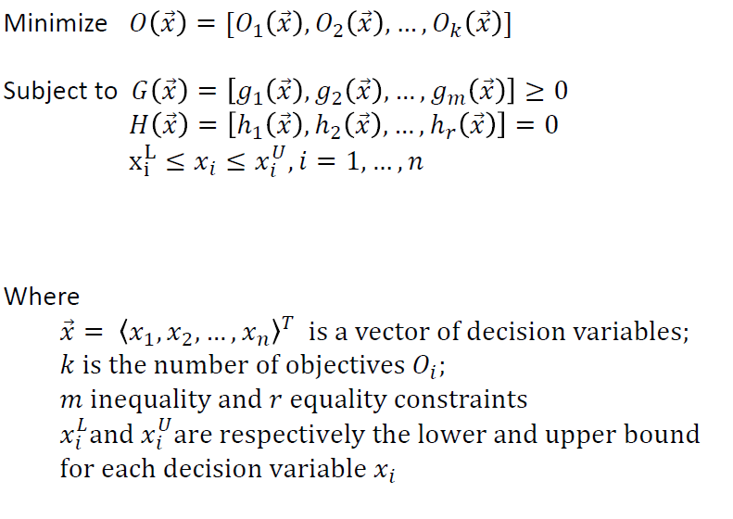
MOO Formalization

Slide 4
MaOPs Problems [1]
more challenging:
  Consist of more than three Objectives
  high computational cost due to increased evaluation of number of points required for Pareto front approximation
  Inability of existing evolutionary multi-objective algorithms to solve many-objective optimization problems
  difficulty to visualize the Pareto front with more than four objectives.

Slide 5
Decision Variables
Can come in different forms
The most import used in the industry is the Variability models

Slide 6
Variability model
Variability model describes all valid configurations of a configurable system by specifying variation points in terms of features and constraints among them [2]
Approaches to Variability modeling:[3]
  Feature modeling (FM)
  Decision modeling (DM)

Slide 7
Feature Variability modeling
these could mass up to thousands with million of constriants
these have a core in SPL
features are usually associated with quality attributes such as cost, defect and reliability.
  Added with user preferences
  This becomes:
  optimal feature selection problem

Slide 8
Data Types configuration
Name | # of Objective Function | Decision Variables | Constraints | Attributed | Interactions | VM Type
DTLZ (4) | 2-20 | None | None | ?? | ?? | DM
WFG (5) | 2-20 | None | None | ?? | ?? | DM
Multi-objective 0/1 Knapsack Problem(6) | 2-4 | O/1 100-750 | Knapsack Limit | No, can be | No, Can Be | DM
LVAT(7) | Augmented | 100-75,000 | Yes | No | neither | FM
SPLOT (8) | None (feature model generator) | multiple | yes | no | no | FM
LSMOP (9) | Matlab Code |  |  |  |  | DM

Slide 9
Data types for MOO
Dimac Files are Constraint files
Feature files are the txt files

Slide 10
Reference
Many-Objective Optimization: Problems and Evolutionary Algorithms – A Short Review
Attributed Variability Models: Outside the Comfort Zone
Cool Features and Tough Decisions: A Comparison of Variability Modeling Approaches
Scalable Test Problems for Evolutionary Multi-Objective Optimization
www.wfg.csse.uwa.edu.au/hypervolume/
https://sop.tik.ee.ethz.ch/download/supplementary/testProblemSuite/
https://code.google.com/archive/p/linux-variability-analysis-tools/source/formulas/source
http://www.splot-research.org/
http://www.soft-computing.de/jin-pub_year.html

